Slide 1
Mini project-3
5G-NR Sub-block Interleaver (PDCCH) using Vivado HLS
Group-13:
Taral Sanka
Likith Kasam

Slide 2
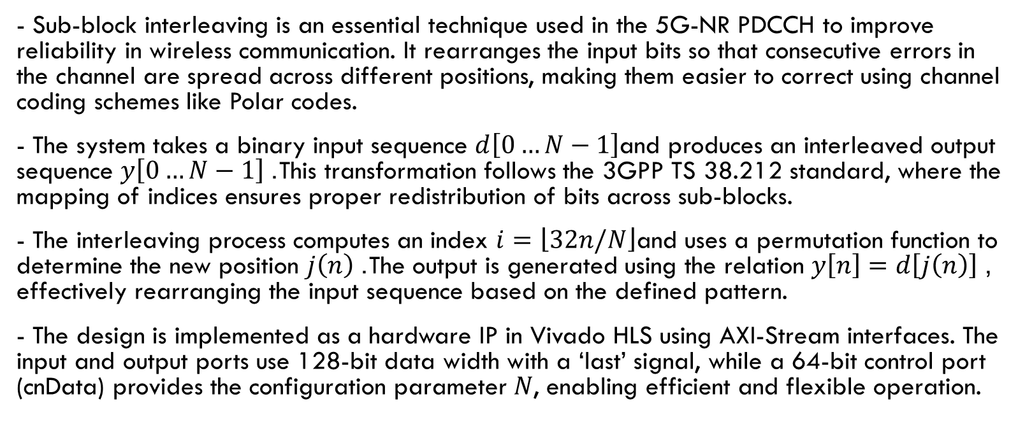
5G-NR Sub-block Interleaver: Concept & Design
- Sub-block interleaving is an essential technique used in the 5G-NR PDCCH to improve reliability in wireless communication. It rearranges the input bits so that consecutive errors in the channel are spread across different positions, making them easier to correct using channel coding schemes like Polar codes.
- The system takes a binary input sequence $d\left[0…N−1\right]$and produces an interleaved output sequence $y\left[0…N−1\right]$. This transformation follows the 3GPP TS 38.212 standard, where the mapping of indices ensures proper redistribution of bits across sub-blocks.
- The interleaving process computes an index $i=\left\lfloor 32n/N\right\rfloor$and uses a permutation function to determine the new position $j\left(n\right)$. The output is generated using the relation $y\left[n\right]=d\left[j\left(n\right)\right]$, effectively rearranging the input sequence based on the defined pattern.
- The design is implemented as a hardware IP in Vivado HLS using AXI-Stream interfaces. The input and output ports use 128-bit data width with a ‘last’ signal, while a 64-bit control port (cnData) provides the configuration parameter $N$, enabling efficient and flexible operation.

Slide 3
Design Choices and Implementation Methodology
- To satisfy the strict latency requirements of 5G systems, a 128-bit data width is used for both input and output interfaces. This allows multiple bits to be processed in parallel within a single clock cycle, significantly reducing the total number of cycles required for computation and improving overall throughput.
- The design incorporates several hardware-aware optimizations to ensure efficient FPGA implementation. Loop pipelining with an initiation interval (II) of 1 enables continuous data processing, while loop unrolling allows multiple bits to be handled simultaneously. Additionally, fixed indexing and conditional logic are used to avoid costly operations such as barrel shifting.
- The implementation follows a structured three-stage approach. First, input data is received through the AXI-Stream interface and stored in an internal buffer. Next, the sub-block interleaving algorithm is applied, where each bit is reassigned to a new position based on the computed index mapping.
- Finally, the reordered data is transmitted through the output AXI-Stream interface while maintaining proper handshake signals. This ensures smooth data flow without stalls, allowing the design to achieve both high performance and compliance with hardware constraints.

Slide 4
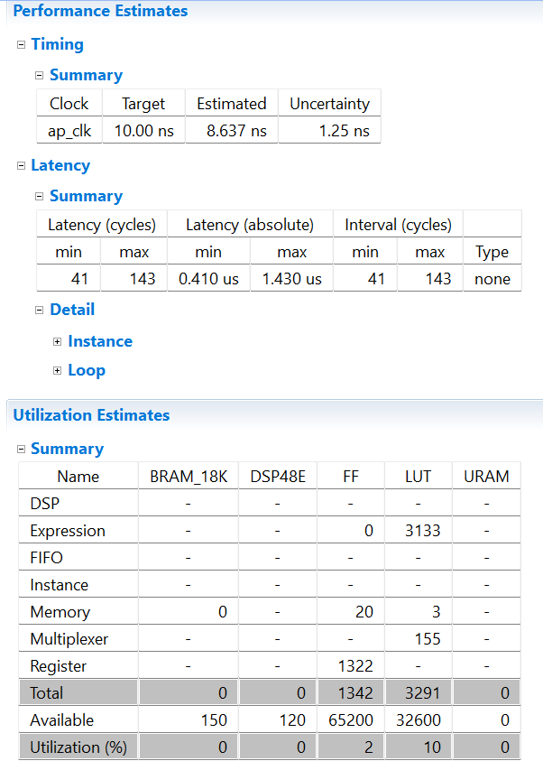
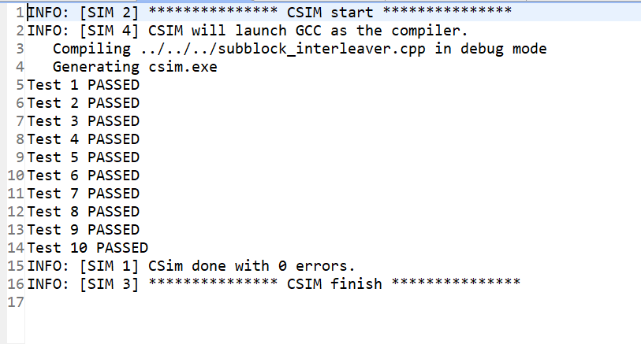
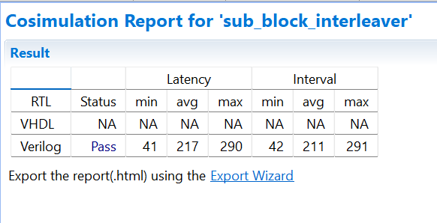
Simulation, Synthesis and RTL Cosimulation Results

Slide 5
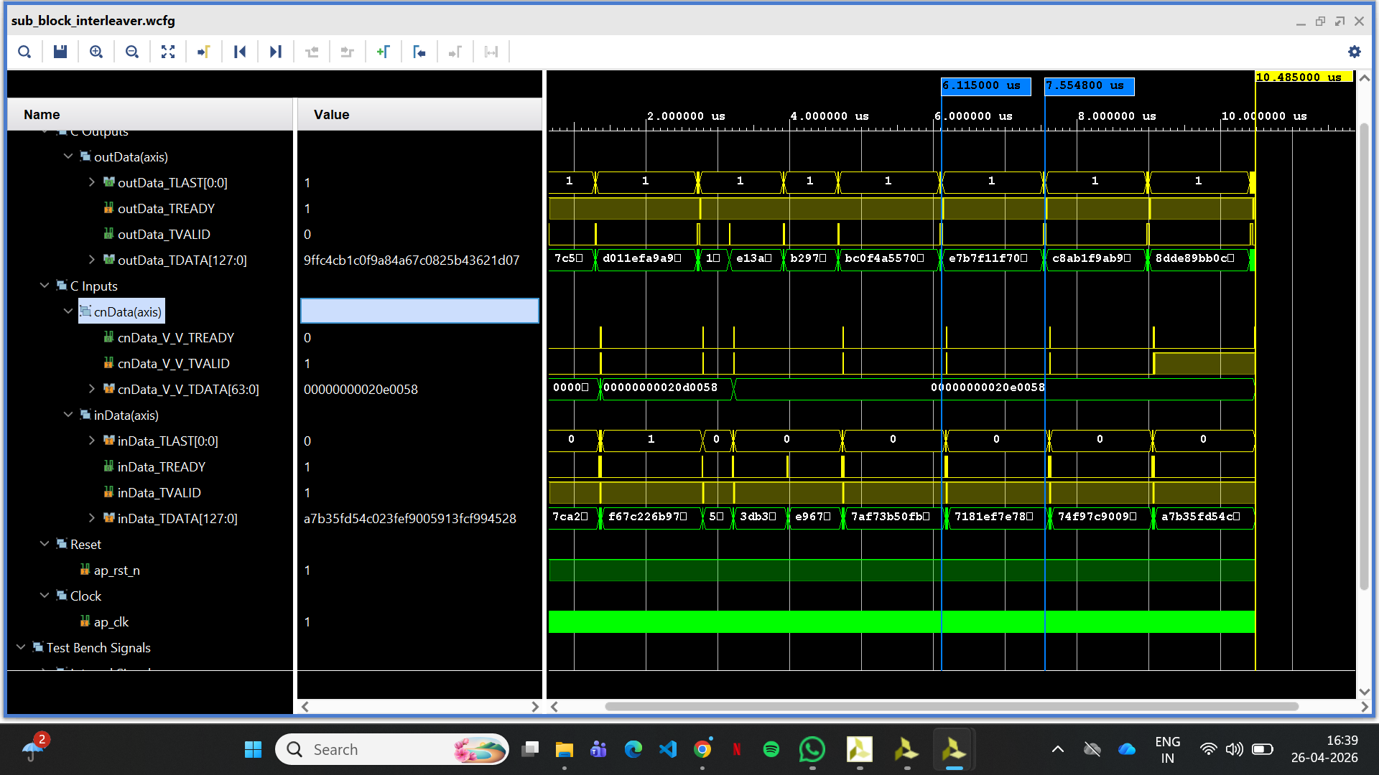
Waveform Analysis

Slide 6
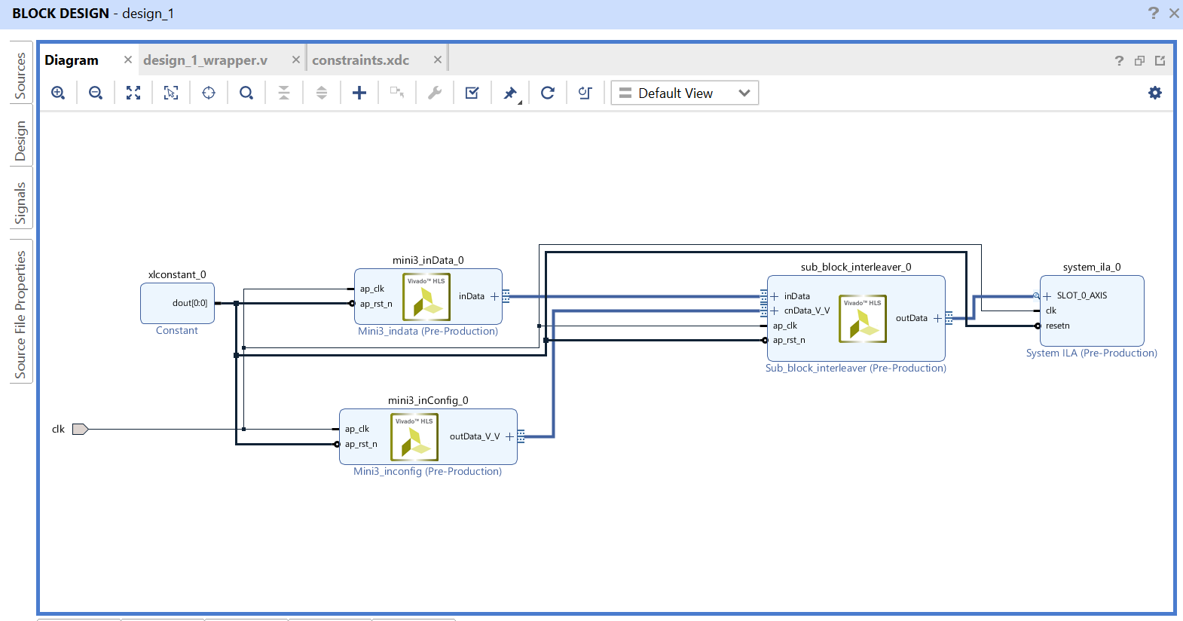
HARDWARE IMPLEMENTATION –Block Diagram

Slide 7
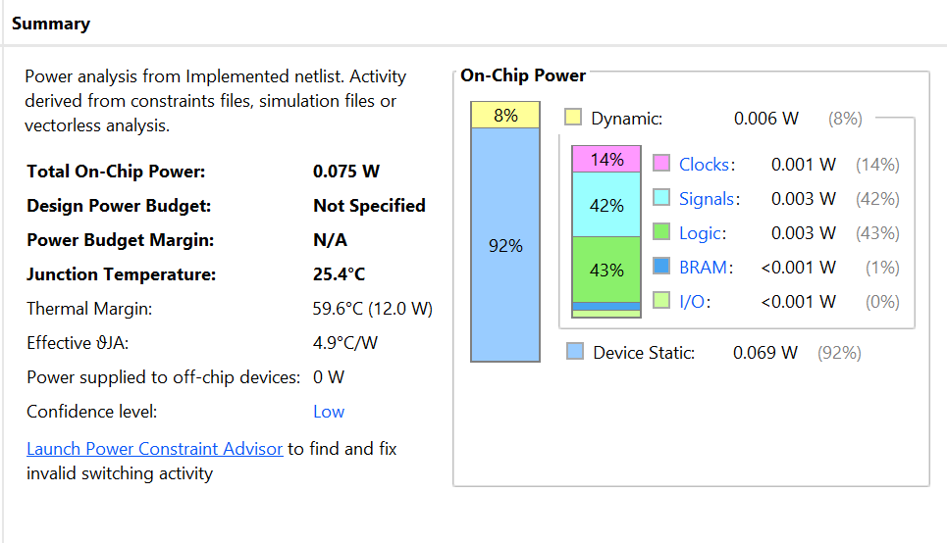
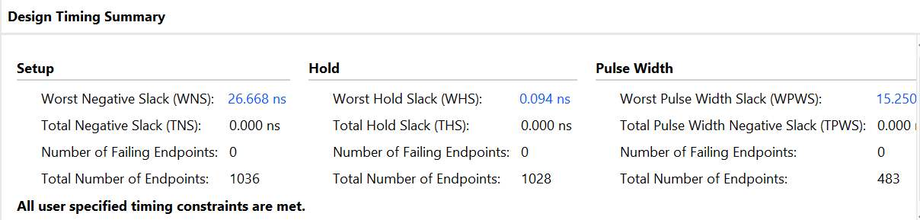
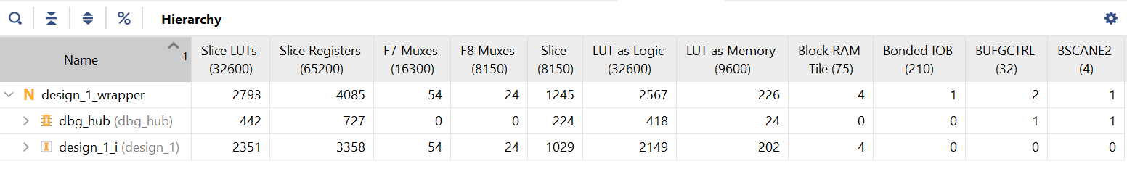
Synthesis report in design suite

Slide 8
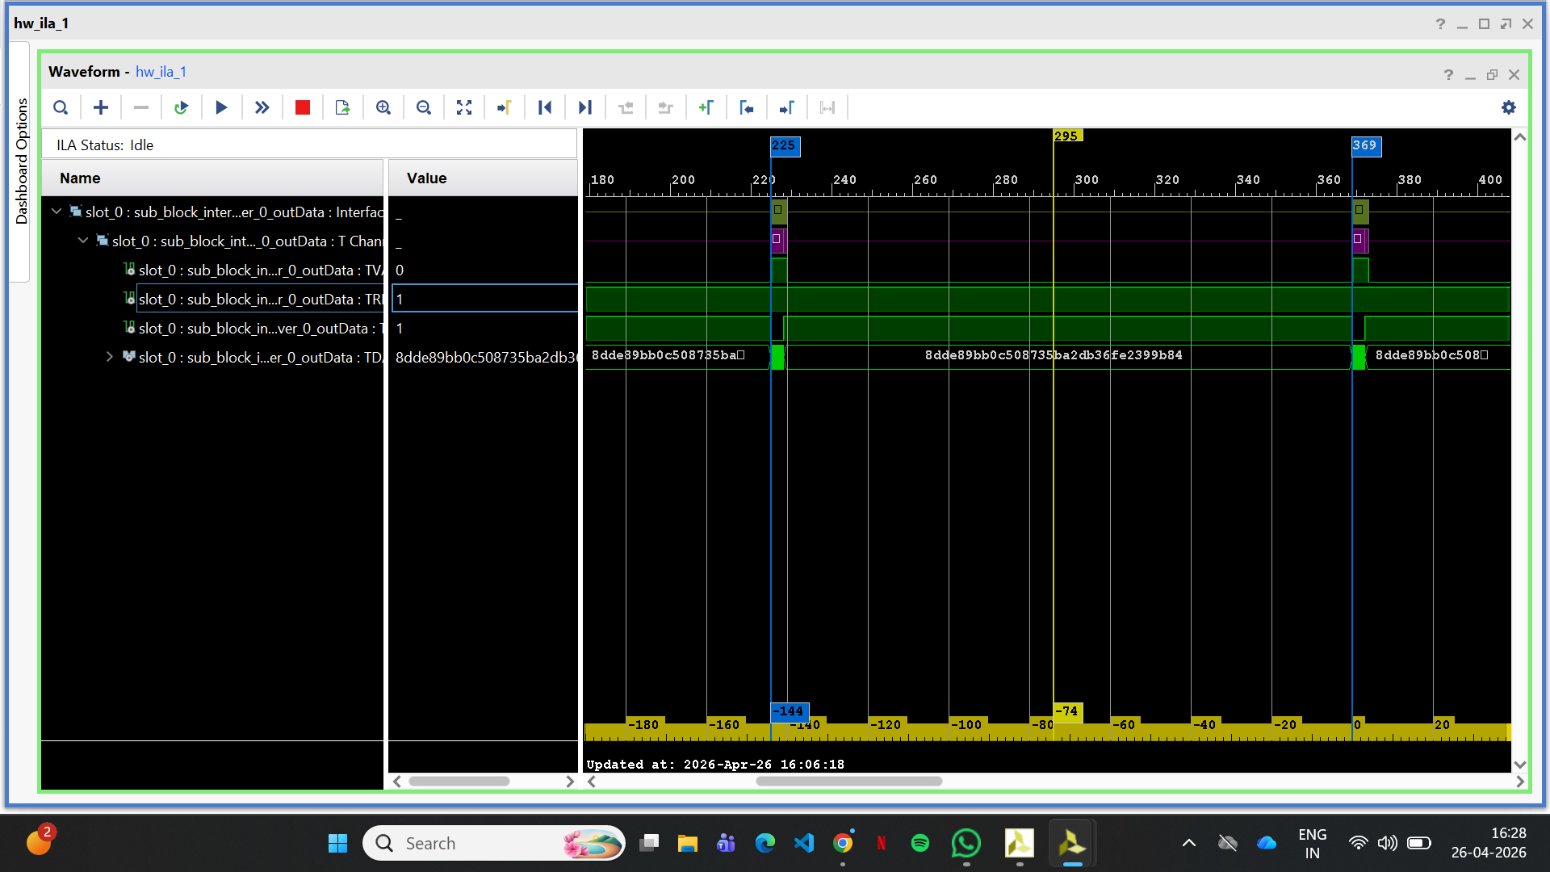
Hardware waveform

